Slide 1
ISIT 324 Software Testing
2020.02.05
Fakes, Stubs, Shims, Mocks

Slide 2
First things first…
A new software disaster!
The big picture: Coding disasters have been with us as long as there's been software, and in the past they've led to exploding space missions and lethal doses of radiation for cancer patients. In this case, the failure of a new app, followed by long delays with a phone-reporting backup system, seems to have crippled the calendar-leading Iowa Democratic caucuses — adding a fresh element of instability to our troubled election system.
- Axios, 2/4/2020: Software disaster sinks Iowa caucus

Slide 3
On the Docket
About the midterm
HW3 Post Mortem comments + HW4 one-day amnesty
HW4 review
Closing remarks on TDD
Test Doubles: Principles
Shims ride-along (maybe…)
Stubs ride-along
Mock object (via Moq) ride-along
In-Class Discussion?

Slide 4
Midterm Notes
In-Class test next Wednesday, 2/12
Complete test in class for full credit
Turn in after class ends, receive 15% deduction
Covers everything through Test-Driven Development
Use whatever resources you want except for live humans (in class or online!)
No submissions will be accepted after 2/12 at 11:59pm.
Format of test:
12 questions.
8 through 12 include a coding problem and require you to build a unit test

Slide 5
Coding tips for the Midterm
Remember the remainder (%) operator?
How to specify an array in a [DataRow]?
What does “executing a defect” mean?
Note: There is an example helper file on the Test Doubles module page you might find useful!

Slide 6
Comments on HW3

Slide 7
Accurate and Efficient Range Checking
Main lesson applicable to all languages: when checking ranges, don’t test the same boundary in two conditions
Two versions: nested-ifs and array-based
Hint: in the nested-if version, you know something is amiss when:
You use an AND or an OR in your condition, or
You have inequality operators going in different directions (< and >=, for instance.)
Example: Range checking

Slide 8
Errors not to be repeated
Use .NET Framework, not .NET Core for all your projects! After HW3, you’ll receive a deduction if you do not.
Write your tests to pass! Some students wrote tests where the expectation was that a test would fail.
If your code doesn’t compile, you’ll receive a zero on the coding portion
Use the formulation I specified for test class and method naming…

Slide 9
From the Testing Frameworks lecture In this class I want you to use this convention:
Put all tests of a method in the same class named <method>_Should
Each test is a TestMethod and is named <expected behavior>_When<state being tested>
Examples:
TestClass public class FahrenheitToCelsius_Should
TestMethod ReturnZero_WhenInputIs32
TestMethod Return100_WhenInputIs212
TestMethod ThrowException_WhenInputIsMinus1000

Slide 10
HW4 One-Day Amnesty
If you have already turned in HW4, and
If you have any of the issues on the “Errors not to be repeated” slides,
Then you may correct the errors and turn in your homework again tonight with no additional penalty.

Slide 11
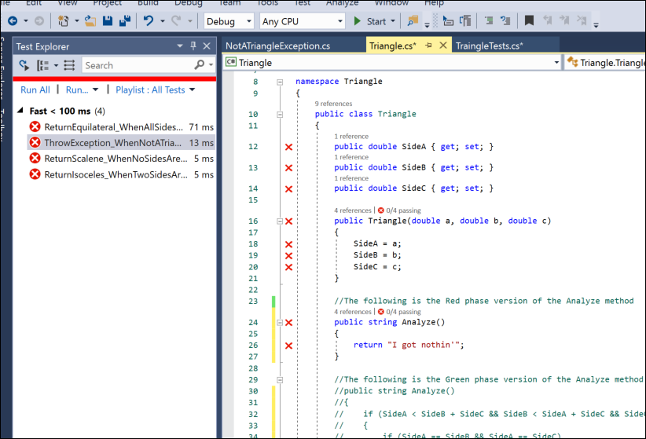
Homework 4 Review Notes

Slide 12
TDD Summary and Wrap-Up

Slide 13
How? Why?
TDD is for Developers, not Testers
Rationale:
A developer has to understand the problem before they can write a test
Writing the test first tends to minimize developer bias
Exposes errors early
Solid unit tests support regression testing

Slide 14
TDD promotes optimal software development
TDD made simple
Write unit tests first (MSTest, NUnit, JUnit, xUnit, …)
Handle dependencies on external elements (MOQ, FakeItEasy, Mockito)*
Get a clue about completeness of tests using code coverage
Optimal because:
Test cases first: you’ll miss fewer
YAGNI**: You’re encouraged not to write extra code “just in case”
When using agile methods, software is deemed correct when it behaves correctly on a specific set of tests. TDD encourages creation of the right set of tests.
*Covered later in the course
**You ain’t gonna need it

Slide 15
The TDD Process: Red, Green, Refactor
RED
(fail)
GREEN
(pass)
REFACTOR
…and do it again
Write a correct test that fails…
Improve code quality…
Add code to enable test to pass…

Slide 16
When to stop testing?
Test until fear turns to boredom.*
How long is a piece of string?
…but code coverage helps, too.
*Kent Beck

Slide 17
Potpourri on TDD
TDD is not the answer for everything (multi-threading, security options, complex configs, UX, etc.)
TDD is just a part of this complete (testing) breakfast
What about private methods? Generally, test through public ones.
Tests should be able to run in any order; no dependencies

Slide 18
Test Doubles
Simulating dependencies on external elements

Slide 19
Test Doubles: Mocks, Fakes, Stubs, Shims
Object doesn’t exist
Behavior is indeterminate
Human interaction-dependent
Hard to set up
Mimic external resources (database, network, etc.)
General test isolation

Slide 20
Tenuous Definitions
Double = a replacement for a production module in testing
Fake = a simple replacement for some component
Shim = a fake that doubles for a system component
Stub = a simple fake that doubles for a custom component
Mock = a complex double that dynamically mimics the behavior of the item being mocked
Can be generated by hand or generated by using a fake or mocking framework.
Here are some alternative taxonomies.

Slide 21
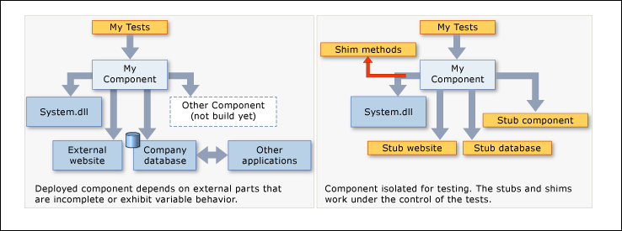
Shims and Stubs

Slide 22
Ride-Alongs using Microsoft Fakes
Shim ride-along: Fake out system date
Stub ride-along: Fake out a component somebody else is building (in our case, a file system)

Slide 23
Date Checker: using a shim
Class:
public static class SpecialDateChecker
Methods:
public static string CheckNewYear()
returns MSG_HAPPY_NEW_YEAR if today is New Year’s Day
returns MSG_BORED if today isn’t New Year’s Day
public static string CheckTuesday()
returns MSG_TUESDAY if today is Tuesday
returns MSG_SAD if today isn’t Tuesday

Slide 24
Shim Ride-Along (TDD)
Create Unit Test project
Under the Unit Test References, right-click on System and select “Add Fakes Assembly”. Wait for System.4.0.0.0.Fakes to appear.
Add the tests using a TDD approach.

Slide 25
Shim Ride-Along
Start with FakesShimStart solution.
Add new Unit Test project
Add reference to SUT project
Under the Unit Test References, right-click on System and select “Add Fakes Assembly”. Wait for System.4.0.0.0.Fakes to appear.
Add these using statements:
using System.Fakes;
using Microsoft.QualityTools.Testing.Fakes;
Now add the tests

Slide 26
Secret DateTime Shim Sauce
using (ShimsContext.Create())
{
ShimDateTime.NowGet = () => new DateTime(2000, 1, 1);
. . .
}

Slide 27
Shims don’t show? Solution:
After adding Fakes Assembly to System assembly (in the test project):
Replace the data in mscorlib.fakes with the XML on the right →
Delete System.4.0.0.0.Fakes reference
Delete System.fakes file
If there's an mscorlib.4.0.0.0.Fakes, delete it, too
Add Fakes Assembly to System again. There may be some error messages, but after a while (maybe > 1 minute) you'll see the assemblies pop up in References. Then you can build.
<Fakes xmlns="http://schemas.microsoft.com/fakes/2011/" Diagnostic="false">
<Assembly Name="mscorlib" Version="4.0.0.0" />
<StubGeneration>
<Clear />
</StubGeneration>
<ShimGeneration>
<Clear />
<Add FullName="System.DateTime!" />
</ShimGeneration>
</Fakes>
Per https://stackoverflow.com/questions/40039081/shimdatetime-not-available-in-system-fakes

Slide 28
Shims and Stubs

Slide 29
The keys to stubs
Your code under test must not explicitly mention classes in another application. You must use interfaces.
In other words, if you’re not using interfaces, you can’t use stubs.
Then, for every interface in the referenced assembly, Microsoft Fakes generates a “stub” class.
You direct your tests to substitute calls to the real class with those in the stub class.

Slide 30
Stubbing out FileSystem.ReadAllText
Use starting point: FakesStubFileSystemStart
Note that the starting point includes a Console App so you can watch the class run without a stub…but you’ll have to supply a file name at the appropriate point in the code (indicated by a comment).
The situation:
We’re building part of a new file system (using the old file system methods.)
Software under test: a method that tests whether a file is empty
We want to use a stub for FileSystem.ReadAllText so we don’t actually need to read and open a file. Capeesh?
We’ll add two tests that use the stub:
One to make sure IsEmpty returns true if the file is empty.
One to make sure IsEmpty returns false if the file has content

Slide 31
Creating a stub
Steps:
Create your SUT class file
Create an interface for the component you want to stub out and a class that implements it
Add a UnitTest project and add a reference to the SUT project
In the Unit Test project, right-click the reference to the SUT project and select “Add Fakes Assembly.”
Now you’ll have a stub version of the interface from 2, above, generated on your behalf. In your test, you can use it to pass data into your SUT. If the interface name is IFooBar, the generated stub is named StubIFooBar

Slide 32
Secret Stub Sauce
var fileSystem = new StubIFileSystem()
{
ReadAllTextString = filename => { return (content); }
};
This code sets up the stub.
StubIFileSystem is a class automatically generates by Fakes to enable you to redirect calls to members of IFileSystem.
ReadAllTextString is a generated method in that class. It is named by taking the original method name (ReadAllText) and appending its return type (String).
This stub is set up so that when the test calls ReadAllText, instead of actually reading text from anywhere it just returns the value from content.
When ReadAllText is called

Slide 33
Mock example using MOQ
Planned: Build a method to query a database and return a list of musical acts for a given genre
Actual: The database guys are running behind. We need to build mock objects to simulate responses from the DB.
MoqExampleStart has the starting point: no tests.
MoqExample includes the tests.
To add tests you must install Moq in the Unit Test project through NuGet

Slide 34
In-Class Discussion 4: Testing Frameworks & TDD
10 Points

